Slide 1
THYROID AND PARATHYROID GLAND
BY
DR. OGWUCHE, ELIJAH
(BSc. MSc. MB,BS)
LAGOS STATE UNIVERSITY COLLEGE OF MEDICINE (LASUCOM), IKEJA.

Slide 2
OUTLINE
INTRODUCTION
PARTS
RELATIONS
ARTERIAL SUPPLY
VENOUS DRAINAGE
LYMPHATIC DRAINAGE
NERVE SUPPLY
APPLIED ANATOMY
REFERENCES

Slide 3
INTRODUCTION
The thyroid gland is the largest endocrine gland in the body
It has a butter-fly shape appearance
It is situated in the neck, anterior to the trachea between the levels of 5th cervical to 1st thoracic vertebrate (C5 to T1)
Weighs about 25g, typically about 5cm long
Not usually visible or palpable
Largest in females than males and increases in size during pregnancy and menstruation

Slide 4
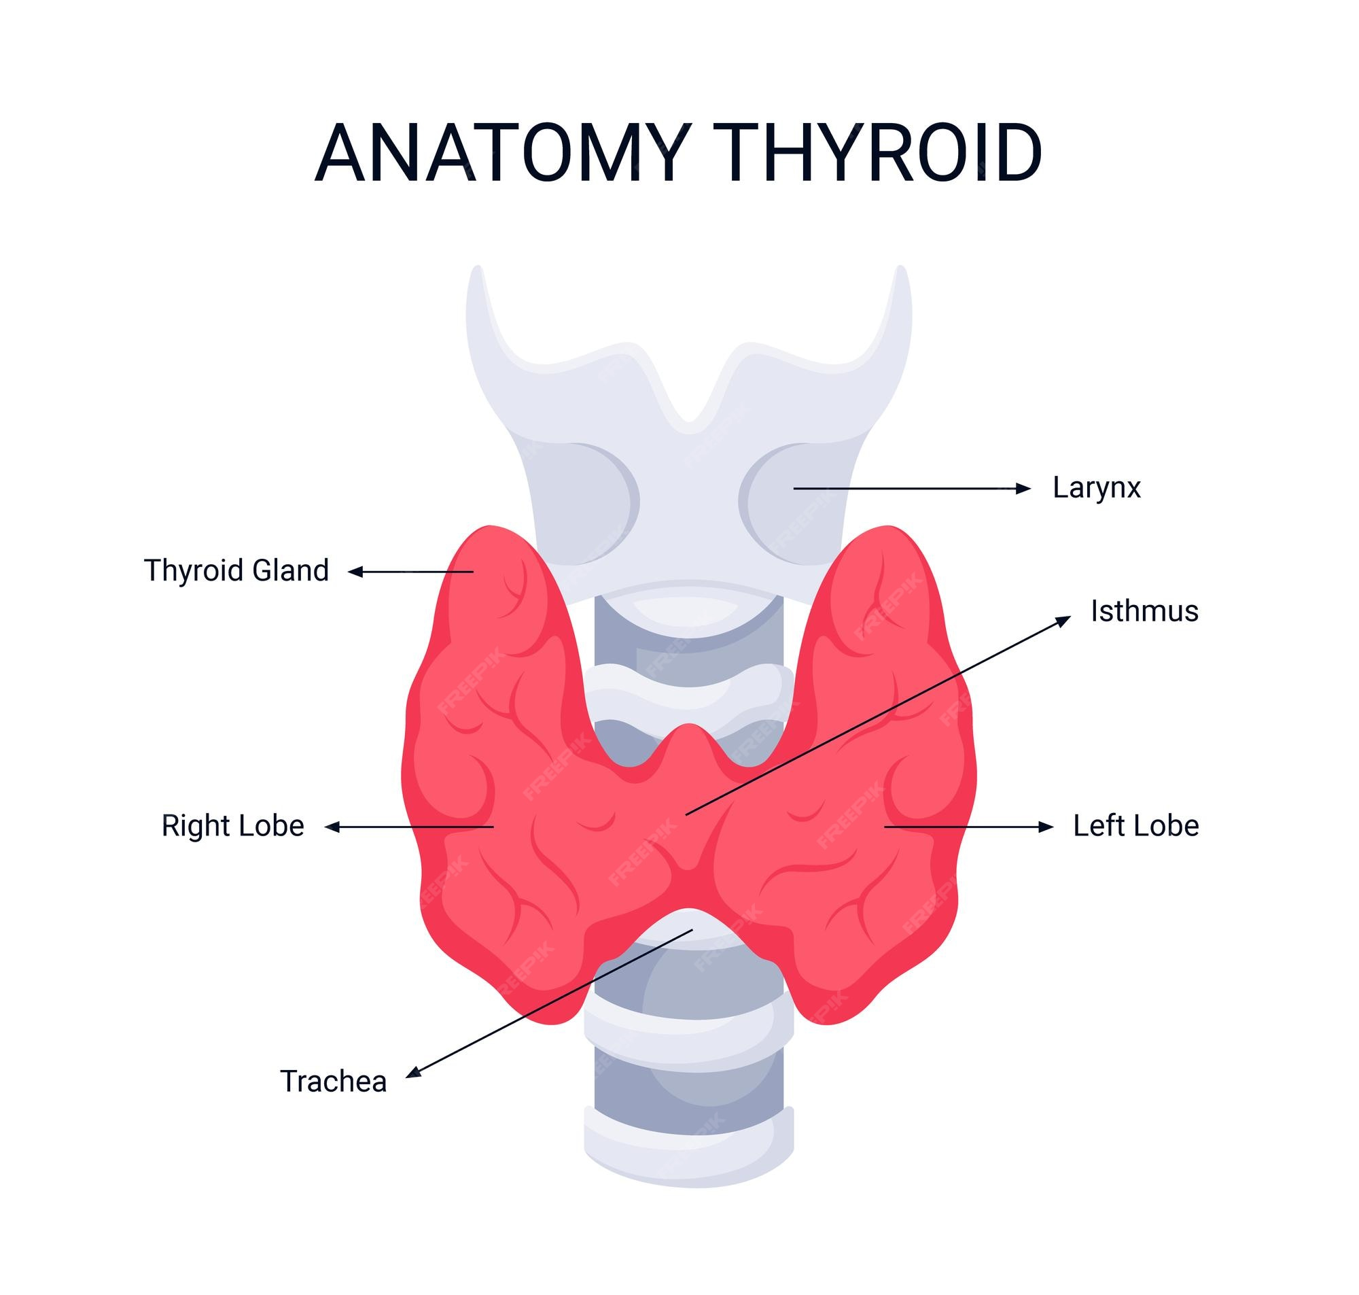
DIAGRAM

Slide 5
PARTS
The thyroid gland is made up of two lobes;
The right and left lobes, connected centrally across the trachea by the isthmus
Occasionally, there is the pyramidal lobe

Slide 6
RELATIONS
ANTERIORLY; Pretrachea fascia, strap muscles and sternocleidomastoid. The internal jugular vein courses over the Isthmus, the thyroid ima artery, a branch of the thyrocervical trunk may be occasionally present.
POSTERIORLY; Parathyroid glands, larynx and trachea, pharynx and oesophagus, the recurrent laryngeal nerve.
LATERALLY; The carotid sheath overlies carotid artery
MEDIALLY; Trachea, esophagus, inferior constrictor and cricothyroid muscle, external laryngeal and recurrent laryngeal nerves

Slide 7
VASCULATURE
Arterial supply; superior thyroid artery, inferior thyroid artery, thyroid ima artey.
Venous drainage; Superior thyroid vein, middle thyroid vein and inferior thyroid vein
Lymphatic drainage; this follows the arteries and include-
i. From the upper lobes they drain into the anterosuperior groups of
deep cervical lymph nodes
ii. From the lower poles they drain into the posterior, inferior groups
of deep cervical lymph nodes.

Slide 8
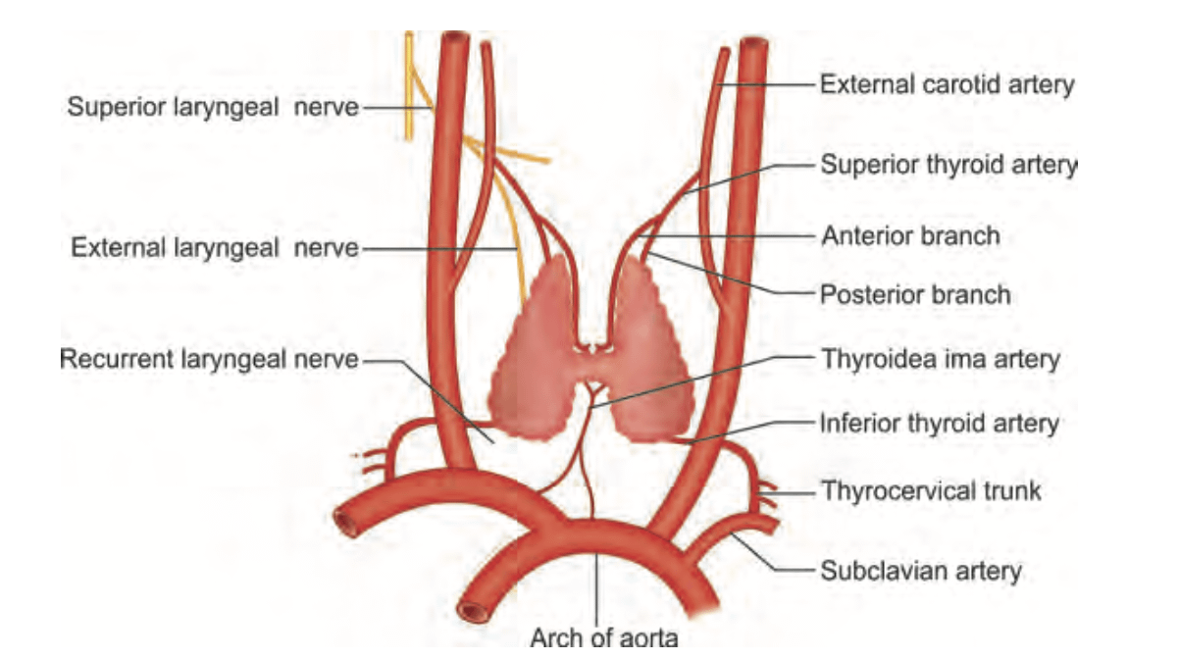
ARTERIAL SUPPLY

Slide 9
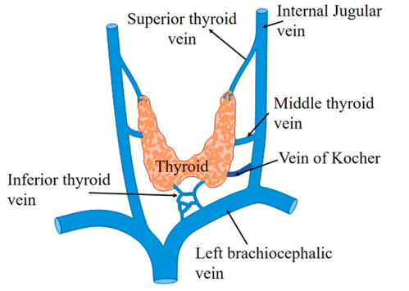
VENOUS DRAINAGE

Slide 10
NERVE SUPPLY
External laryngeal and recurrent laryngeal nerve
secretomotor are derived from the;
Superior
Middle and
Inferior cervical sympathetic ganglia

Slide 11
FUNCTIONS
Basal metabolic rate
Psychic growth
Calcium metabolism

Slide 12
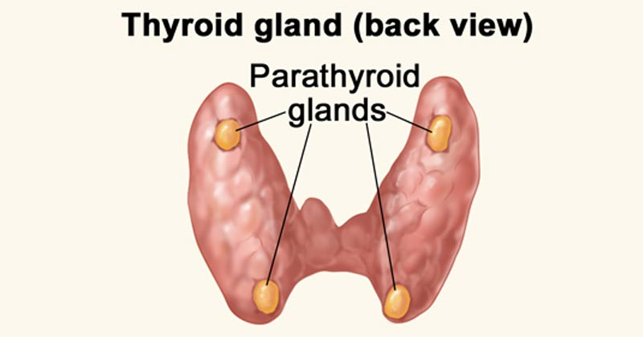
PARATHYROID GLAND

Slide 13
PARATHYROID GLANDS
They are four small pea-sized endocrine glands located on the posterior surface of the thyroid gland, embeded within its tissue
They are small flattened oval shaped glands
Responsible for the production of parathyroid hormones (PTH) that regulate serum calcium levels

Slide 14
PARATHYROID GLANDS
The superior parathyroid glands are derived embryologically from the fourth pharyngeal pouch while
The inferior parathyroid glands are derived from the third pharyngeal pouch
variations; in few individuals, the inferior Parathyroid glands are located as far inferiorly as the superior mediastinum

Slide 15
VASCULATURE
Share similar blood supply as the thyroid gland
Blood supply; chiefly from the inferior thyroid artery, collateral supply from the superior thyroid artery and thyroid ima artery
Venous drainage; superior, middle and inferior thyroid veins
Lymphatic drainage; paratracheal and deep cervical nodes
Nerve supply; sympathetic nerve supply is from the thyroid branches of cervical ganglia which are vasomotor
The secretomotor supply is hormonal

Slide 16
FUNCTIONS
The main function of the parathyroid glands is regulation of serum levels of calcium by releasing parathyroid hormone (PTH)

Slide 17
APPLIED ANATOMY
Ectopic thyroid
Thyroglossal cyst and fistula
Goitre
Hypothyroidism, hyperthyroidism
Hashimoto’s thyroiditis
Damage to right and left recurrent laryngeal nerve
hypocalcaemia

Slide 18
REFERENCES
Guyton, Arthur C, and John E Hall. Textbook Of Medical Physiology. 11th ed., India, Elsevier Saunders, 2007 ,.
Jamieson, Robert W. et al. "The Cervical Sympathetic Ganglia: An Anatomical Study of 100 Cervicothoracic Dissections." Quarterly Bulletin Of Northwestern University Medical School, vol 26, no. 3, 1952, pp. 219-227.
Mescher, Anthony L, and Luis C Junqueira. Junqueira's Basic Histology. 13th ed., New York, Mcgraw-Hill Medical, 2013 ,.
Moore, Keith L et al. The Developing Human. 9th ed., Philadelphia, PA, Elsevier-Saunders, 2013 ,.

Slide 19
THANK YOU 4 LISTENING

